Slide 1
The Cayley’s Vision
A Tribute TO SIR GEORGE CAYLEY, FATHER OF AVIATION

Slide 2
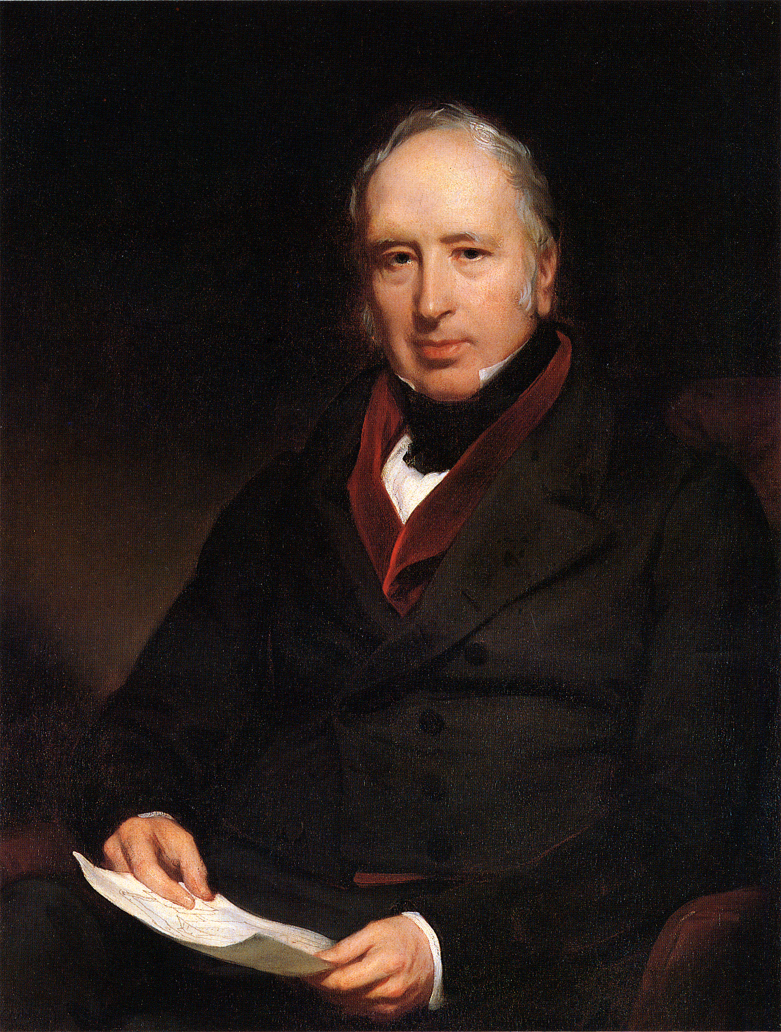
Sir George CAYLEY
Sir George Cayley, 6th Baronet (27 December 1773 – 15 December 1857) was a prolific English engineer and is one of the most important people in the history of aeronautics. Many consider him to be the first true scientific aerial investigator and the first person to understand the underlying principles and forces of flight.
In 1799 he set forth the concept of the modern aeroplane as a fixed-wing flying machine with separate systems for lift, propulsion, and control. He was a pioneer of aeronautical engineering and is sometimes referred to as "the father of aviation."

Slide 3
The Cayley Vision
The project named ‘The Cayley Vision’ is an exclusively tailored idea in order to pay a tribute to the Father of Aviation, ‘Sir George Cayley’.
Sir Cayley discovered the four forces which act on a heavier-than-air flying vehicle: weight, lift, drag and thrust.
He constructed the first flying model aeroplane and also diagrammed the elements of vertical flight. He designed the first glider reliably reported to carry a human aloft.
He dreamt of a sustainable aviation industry which would grow beyond the boundaries and would serve the world’s extreme migrations from the heart of one nation to the soul of another.
This project is built on the perspective of the creator and discuss some of the paucities of the aviation industry and the corresponding imperishable solutions in regards to them.

Slide 4
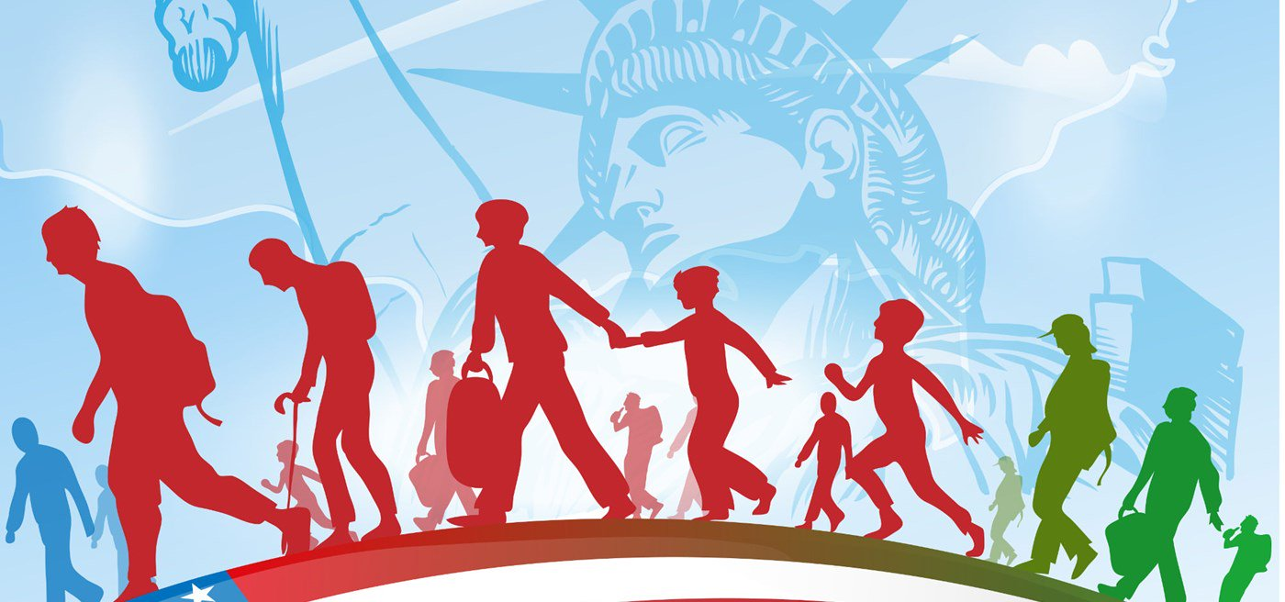
Complications

Slide 5
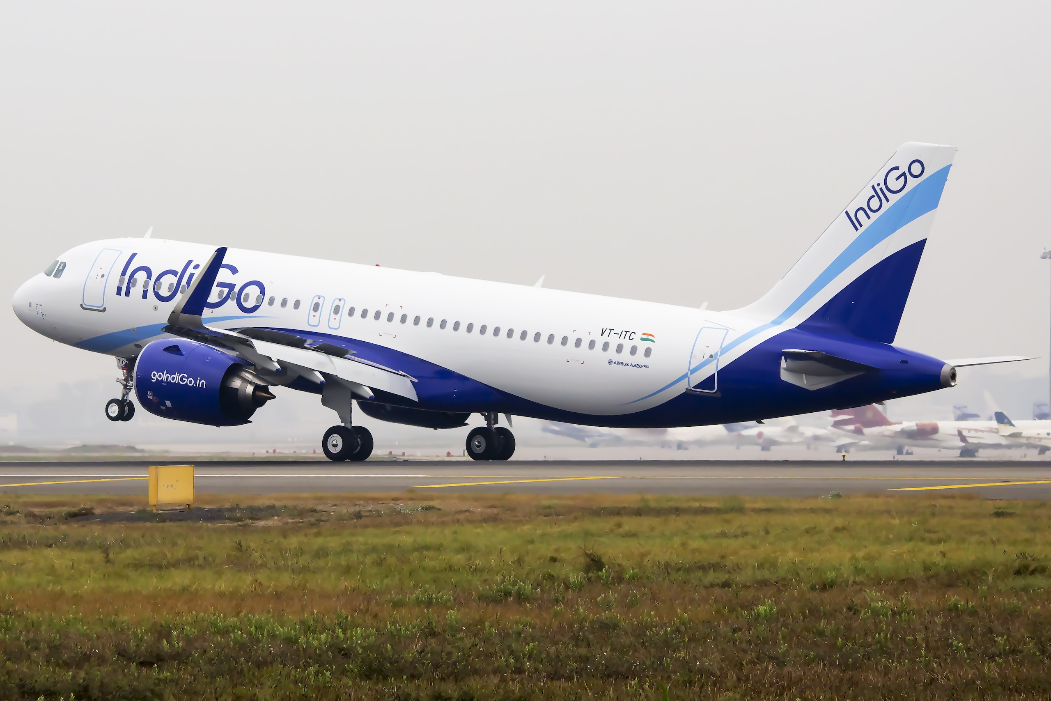
Prime Airline Availability
Prime Airline means the ones which proves to be the ambassador of the nation. Like Etihad Airways is to Abu Dhabi, or you can say Emirates is to UAE or Lufthansa Airlines is to Frankfurt, we do not have a much well renowned prime Airline for our country India which would travel across the world connecting the hearts and soul of the other nations from or motherland.
On the other hand, Indigo is one of the biggest airlines of the nation but it cannot be regarded as the Prime Airline as it does not have any extreme international connections.

Slide 6
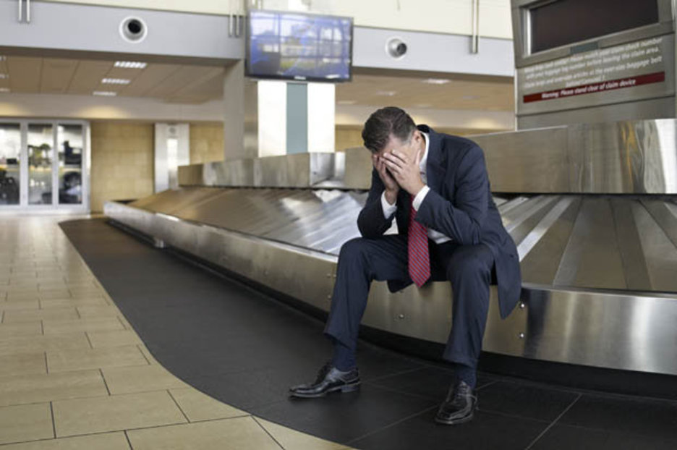
Baggage Lost and Damage Issue
Every 1 in 120 passengers report about the lost baggage or the baggage being excessively damaged. The graph for such cases points to a number of 384,019 just in 2017 alone in the United States. The problem arises when the airlines does not fulfils their duty efficiently despite of crediting a large sum of money from the passengers.
It should be noted that the handling market is $2.74 billion in 2013 and is expected to grow by 2.1% until 2023 This is one of the major factors the airlines have to bear the large amount of loss against the compensation of the lost and damaged baggage of the passenger.

Slide 7
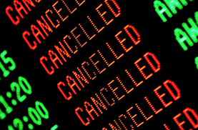
Cancellation of Non-stop Flights without consent
Some airlines cancels your non-stop flight from your source to destination in case of the passenger’s quantity being too low and directly books you on the other available connecting flight or refunds you back the appropriate amount against your cancelled itinerary without your consent.
This is done when flying an aircraft proves to be much expensive relative to the profit earned by the travelling passengers. Passengers have a full right to raise a voice against it if this situation is disturbing their schedules or if they are getting delayed by more than 2 hours in reaching to their destination.

Slide 8
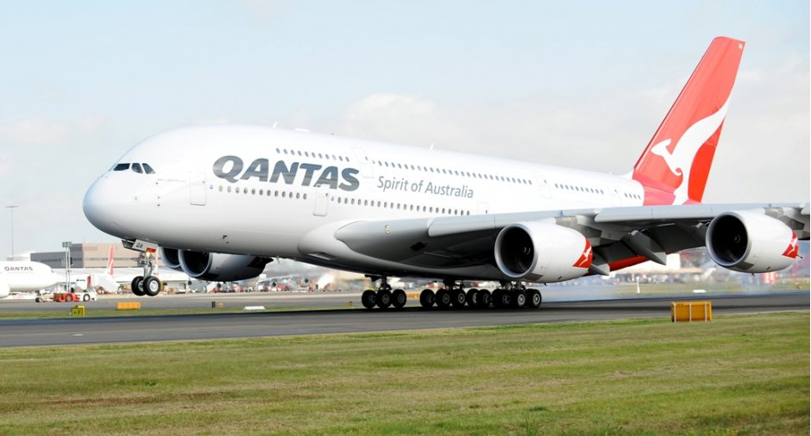
A380’s force to build new terminals
Airbus A380’s are the largest passenger carrying aircrafts available in today’s time with the highest capacity of 600 people on-board including the pilots and the cabin crew. The current densest configurations of the people on-board have been marked up to 538. The are the most massive metal body aircrafts weighing up to 361,000 kilograms.
Due to this extreme dimensions, it cannot be easily landed and taken off from any runway. For the operational landing and take off of the A380, a special runway with enabled CAT III landing systems should be available. This forces the airports to build the new terminals in order to meet the expectations and the growing demands of the next generation aviation industry.

Slide 9
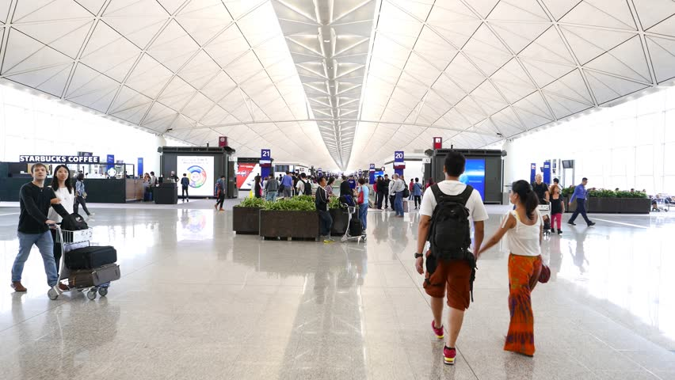
Long distance between Entry Gates, Security Checks and Embarking Gates
The distance between the entry gates, check-in counters, security checks and embarking gates decide the fate of the passenger whether he/she will be able to board the staircase to 35000 feet high in the sky. The passengers who are new to the system and are not the frequent travellers or are senior citizens or physically challenged found it very difficult to travel from one corner of the terminal to the other.
Despite being provided with all the sign boards and display screens pointing to their destinations made available on the terminals, the reason which stands with pride is their unfamiliarity and less knowledge about the process being done to board the flight. Every type of passenger is now seen on the airports fighting for their missed flights just because of the misconceptions and misunderstanding the sign boards to reach their destination.

Slide 10
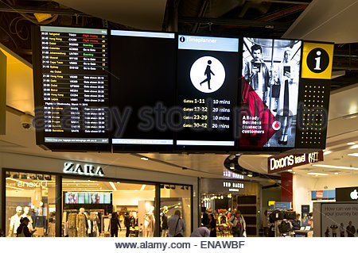
Absence of Digital Individually Optimized Real-Time Information
Although, the digital screens are seen all over the terminal in order to help out the passenger to know the status of his flight but the absence of real-time optimized information individually for each passenger breaks the link to the direct communication between the airline and the passenger.
The system should instead tell the passengers that how far are they currently from their destination and how much time will it take them to reach their just detecting their present location with the help of their PNR. In this way, airlines and the airport’s system will be able to directly communicate with the passengers and will eventually provide a sense of satisfaction to them.

Slide 11
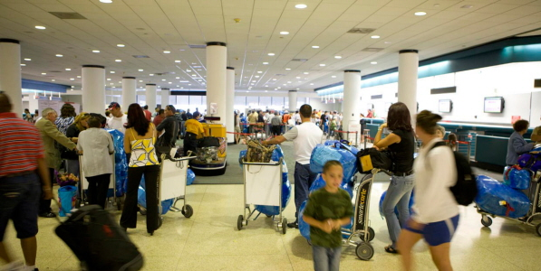
Less Dwell Time for Passengers
Dwell time means the time have in spare after getting done with all the formalities of check-ins and security checks and documentation (in case of abroad flights) and are now ready to spend the remaining time in the duty free areas which ultimately raises to revenues of the airport up to 60%.
Every passenger in an average spends $7 on shopping and purchasing commodities for themselves and friends. The formalities being consuming much of the passenger’s valuable time results in ending up of his dwell time which ultimately puts impact on airport’s revenues calculated annually.

Slide 12
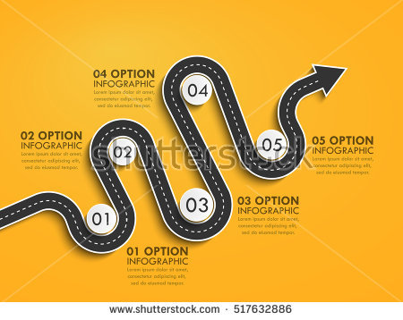
No Serpentine Walkthroughs
According to the scientific studies, the serpentine walkthroughs aid the passenger to observe the surroundings more efficiently as compared to the straight path to the destination. This is the very rare issue faced by generally all the Indian Airports that they do not have the facility of the Serpentine Walkthroughs which could have helped the passenger in observing the environment more deliberately and also have forced them to spend more on the Duty Free as they do now.
These types of walkthroughs can play an immensely important role in the annual revenue no anticipated for the airports.

Slide 13
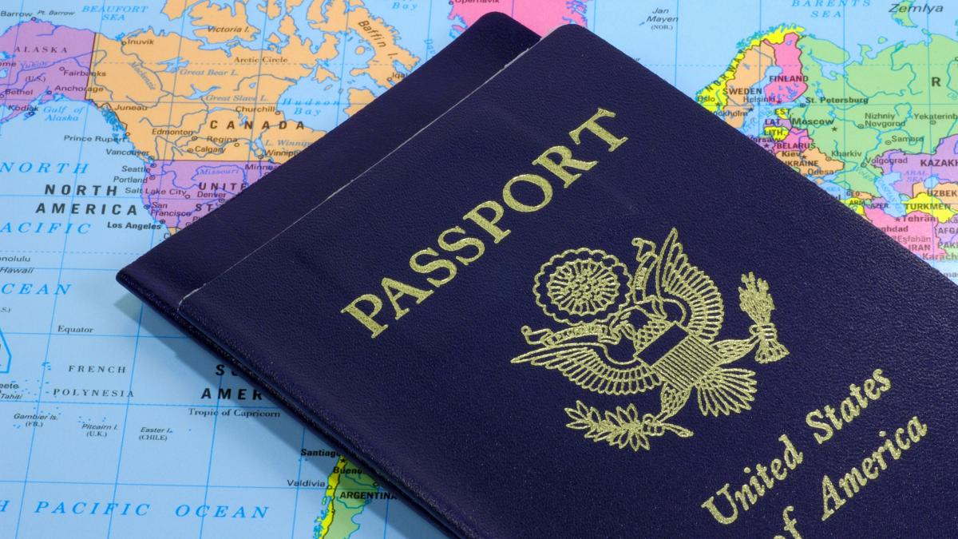
Immigration and Custom Check Issues
The term Immigration is used for the passengers who have left their original country permanently or temporarily due to certain reasons and have entered into a new nation and needs to be done with the documentations and passport stamps by that country authorities before getting out of the airport.
Custom checks refer to the intensive checking of the arriving or departing passengers along with their baggage in order to suspect anything illegal or which can cause harm to the other fellow passengers.,
Both these tasks are one of the greatest assets need to be duly completed by the passengers in order to successfully complete his/her journey.

Slide 14
Resolutions

Slide 15

Consolidated Systems for every essential of the passengers
Consolidated Systems means the applications installed inside the terminals will serve all the essentials need to be done mandatorily by the passengers before boarding their. This system will handle all the essential tasks need to be done by the passenger all in one go. The benefit of such systems is that it will help to cut shot the long queues in which passengers has to struggle in order to get their tasks done.

Slide 16
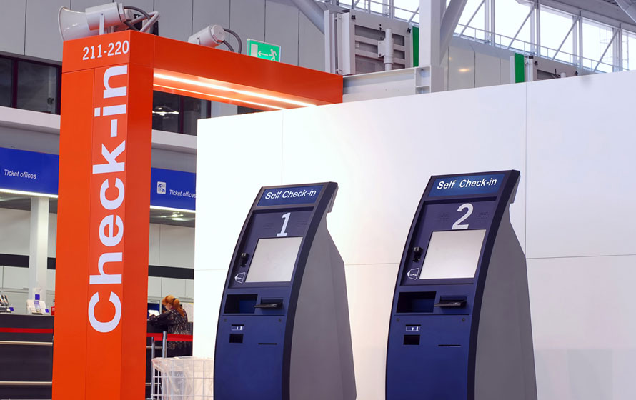
Digital Check-ins and Self Check-ins
The Digital Check-ins and Self Check-in Kiosks are one of the very important implications we need in this time in order to increase the dwell time of the passengers and thus give them some relaxations from the staff controls which are always there to help them. The passenger has to enter the unique PNR Number and the machine automatically prints their tag which they have to flip and tie it on the handle of the suitcase/trolley. The scanner will judge the dimensions and what’s inside the bag. The passenger then has to simply place the bag on the trolley and then the sensors will automatically judge that in which slot the suitcase needs to be sent in order to load it into the correct flight.

Slide 17
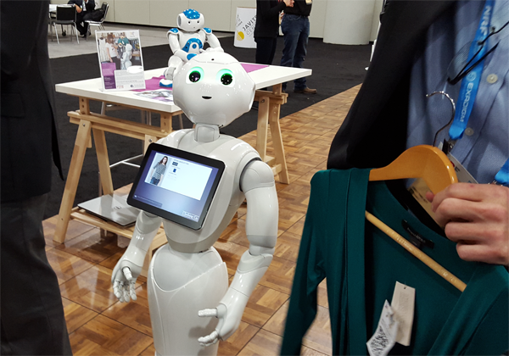
Robo-Retailers @ Duty Free
These Robo-Retailers will prove to be the very essential part of the Duty Free inside the terminals. They will be much more quick and accurate as compared to the human retailers. Since there is endless stock of innumerable varieties in the Duty Free portion, hence it becomes very hectic for the passenger to choose the right product for them in surplus of the stress of getting back to the boarding gates as soon as possible. Thus, these roots will automatically judge the desires what the customer wants and thus will prove to be a great player in saving time and assets of both, the passenger and the airports.

Slide 18
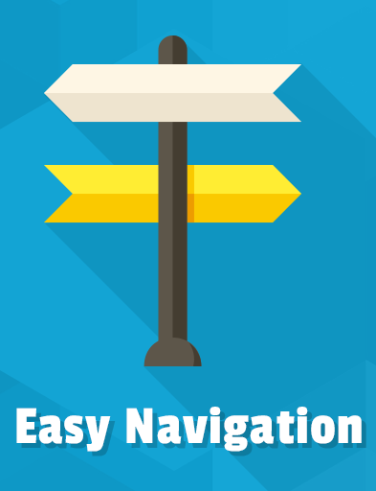
Easy Navigations and Wayfindings
Present navigations installed inside the terminals sometimes confuse the unfamiliar ones and the newbies. The digital real-time navigations will guide you from top to notch through the airport by just detecting your location and will automatically be optimized inside your smartphones to help you reach the destination as soon as possible.
Move walks installed by ThyssenKrupp proves to be a very important property for the airport premises. These gadgets can be further modified to guide you with the real time information like how much time is left for you to reach the boarding gates and to move in which direction along with any possible shortcuts.

Slide 19
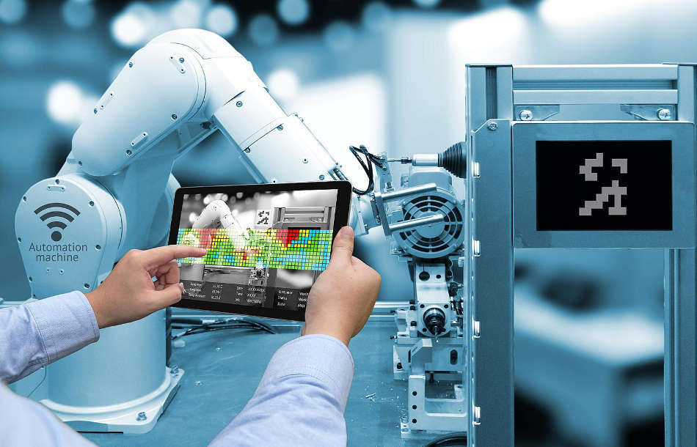
Digital Maintenance of the Aircraft
It is possible to digitally maintain the aircrafts by just installing the robots inside the cabin which will quickly and accurately clean all the garbage after the plane is being laded and all the passengers have been de-boarded. The cleansing robots can be controlled by a digital administrative panels and can give a perfect look to the interiors of the cabin. Along with that, they can also judge the quality index of the food which is being served to the passengers on board.

Slide 20
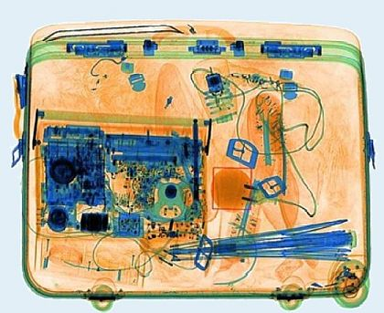
Dynamic Security Screening Environment
Nowadays, the security officers gets tired of screening each and every bag for the illegal goods and drugs. This dynamic security screening environment will judge the 94 signs of anxiety and fear and will automatically notify the passenger’s PNR no. to the security officer and then they will judge the bag extensively through dynamic checking. This checking will automatically alert the security officers for any kinds of drugs and illegal goods being carried from one part of the world to another.

Slide 21
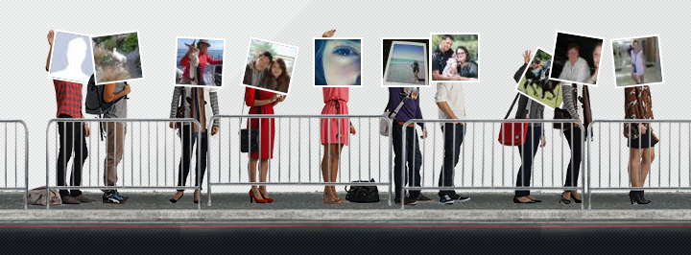
Next Generation Checkpoint Queues
These Checkpoints will include the PNR numbers instead of the human being standing their for a very long time. These checkpoint queues will be full automatic and will perform all the essential functions and operations needed for the security check posts without a single intervention of the human.
Next Generation Checkpoint Queues, as the name suggests, all the work will be done without the single interruption or intervention of the human and the passenger will be notified at last that all the work has been done and he/she is eligible to proceed for further formalities.

Slide 22
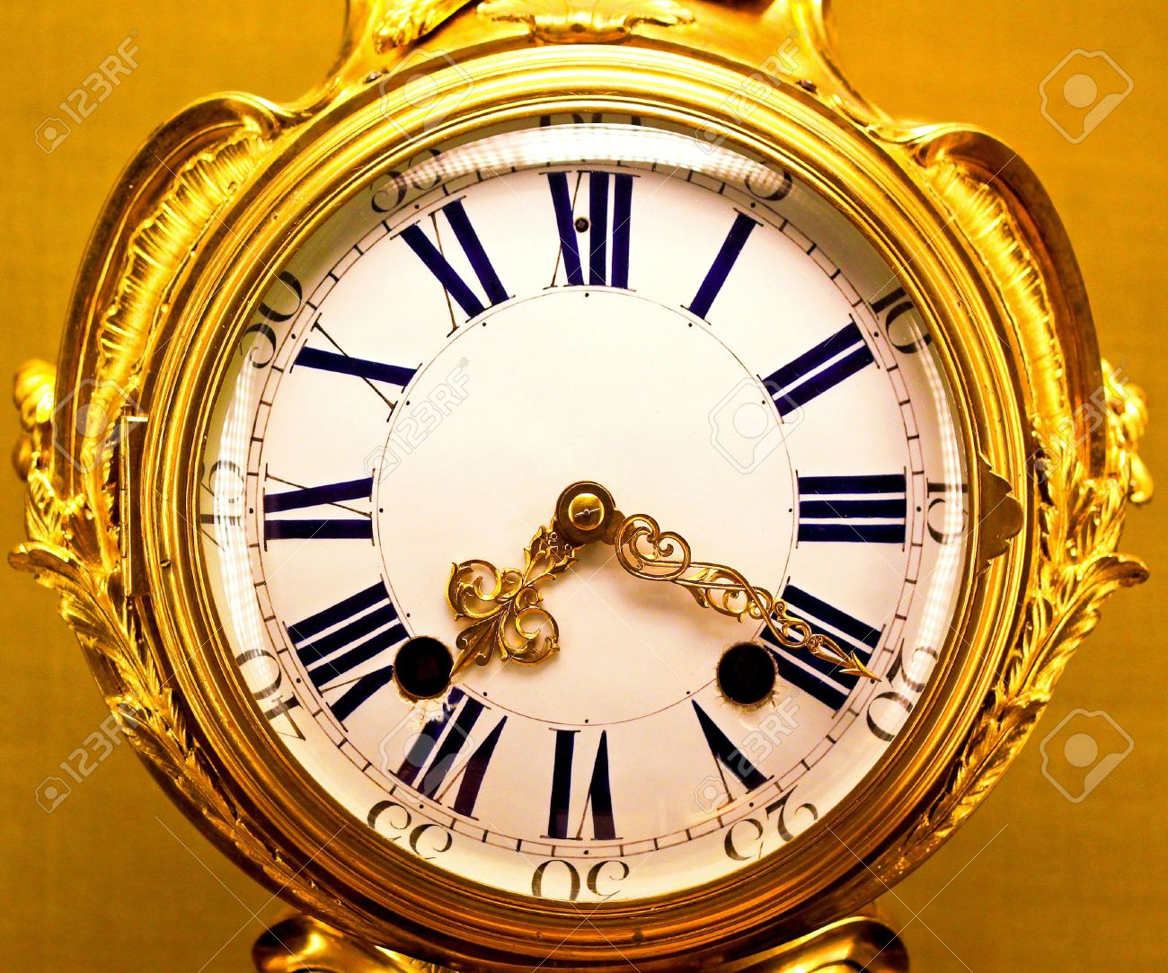
Extended Dwell Time, More Golden Hours
Making all the tasks automatic will surely increase the Golden Hours of the passenger which is also known as the Dwell Time. Every passenger likes to spent the precious dwell time either in Lounge by in the Duty Free shops. Making all the functionalities automatic will provide more dwell time to the passengers and will eventually lead to an increase of 30% to 60% incrementation in the profits, assets and revenues of the airport.

Slide 23
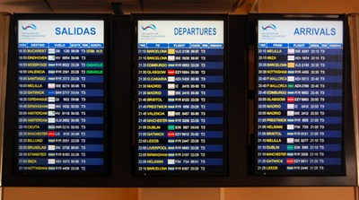
Helvetica and Frutiger Real Time Optimized Digital Screens
Helvetica and Frutiger Screens are used so that the information can be seen from even 120 feet away and there is regular real-time updation which can help a lot the passengers and can save their ample amount of time.

Slide 24
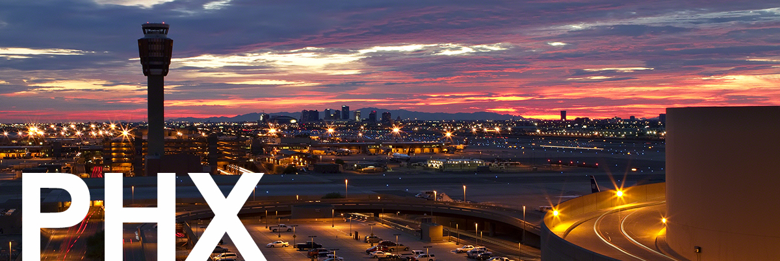
Phoenix Sky Harbour Psychometric Order
Phoenix Sky Harbour Psychometric order can be used in the terminals to arrange the shops in the serpentine psychometric order as a result of which, the airport can lead to a sustainable development and the user and the terminals can both be benefitted. There is a psychometric behaviour in order to which the shops are arranged.

Slide 25
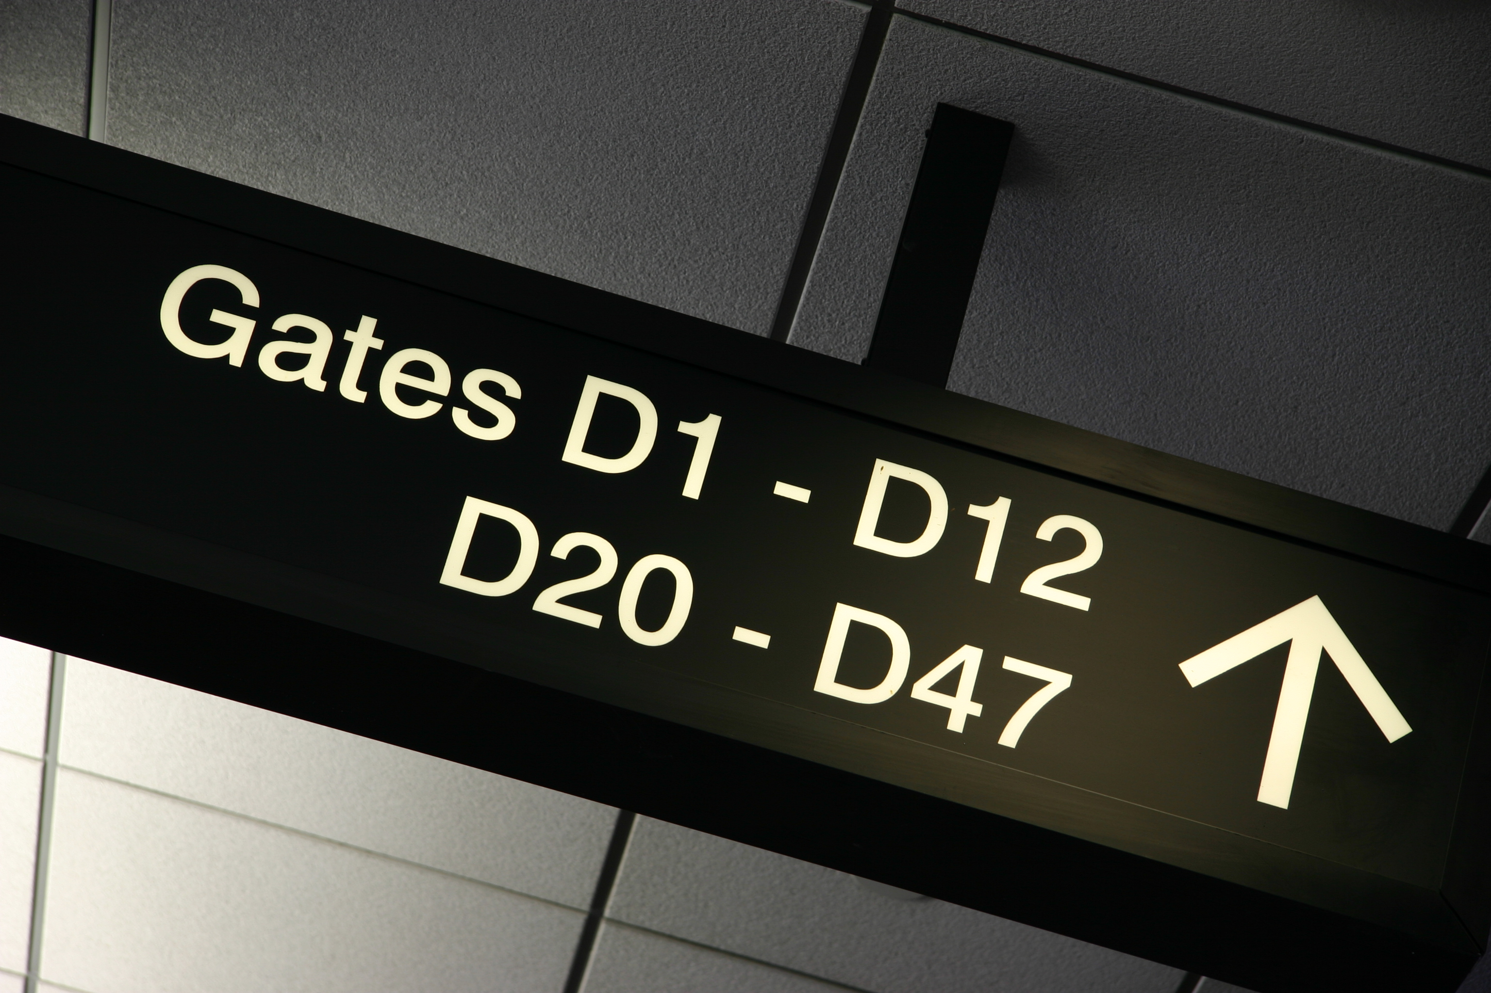
Dynamic Gate Signs
Dynamic Gate Signs can be used to prevent the passengers from hassle of running here and there in the unknown directions in the airport. The gate signs can be changed when and where needed so that it prevents creating a kiosk over the terminal and the confusion between the old and the new signs.
Also they can be connected to the passenger’s boarding pass via GPS and can guide them to reach to their gates as soon as possible.

Slide 26
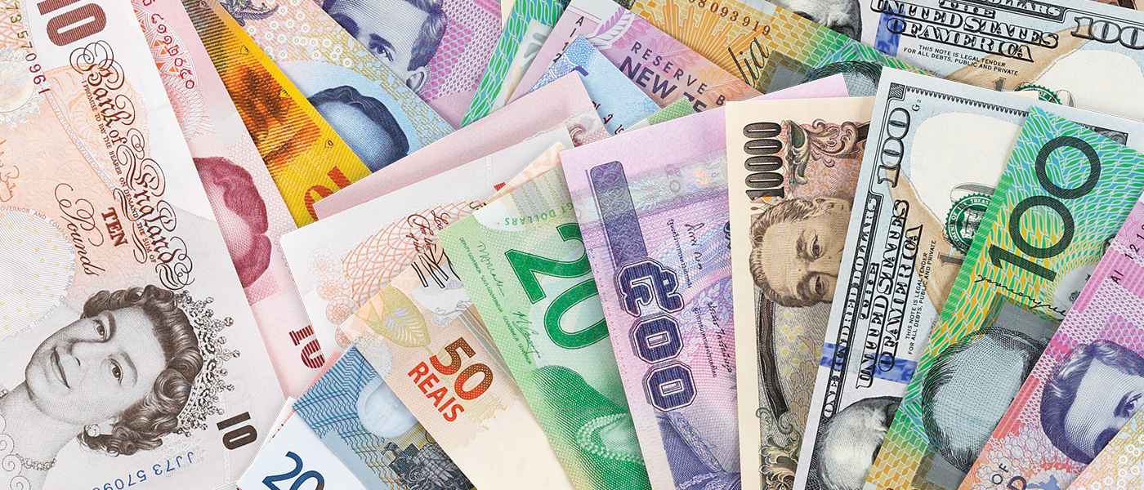
Digital Currency Exchange & Trip Insurance Systems
Digital Currency Exchange can be used in order to spent the extra money as a commission by the passengers. Any currency can be exchanged into any denomination of the currency of that native country by a fully automated digital process.

Slide 27
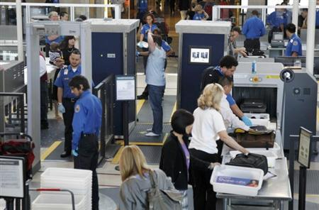
Screening of Passengers by Observational Techniques (SPOT)
Security officers screen the passengers by 94 anxiety and fear symbols on the face. This technique is called as the Screening of Passengers by Observational Techniques. This can also be utilized in a digital format. The sensors can detect the face expressions and can thus suspect the thefts. This will reduce the crime up to a remarkable extent. This can even ask some questions by which it can judge the expressions of the passenger.,

Slide 28
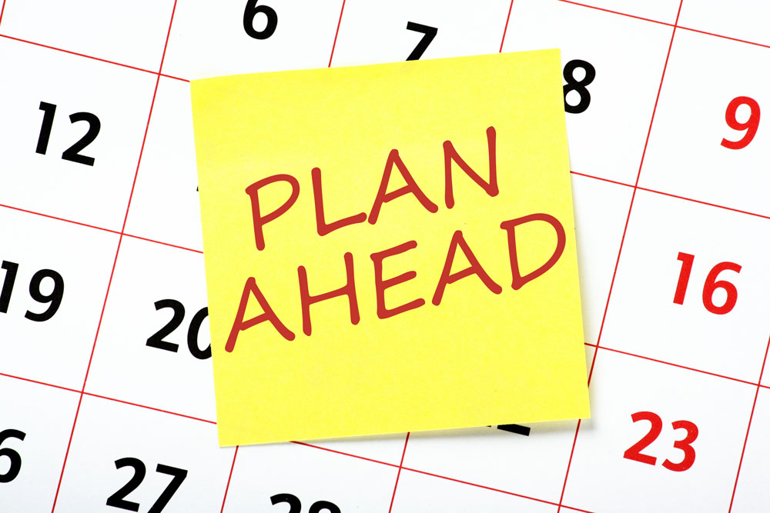
Plan Ahead, Go Local!
Passenger likes local stuff and the terminal should look ahead to process the same rather than some international artificial and expensive stuff.

Slide 29
Conclusion

Slide 30
This project appeals for a sustainable growth of both, the passengers as well as the airlines in order to ease the futuristic steps for both of them.
In association with the step of ‘Digital India’, led by our Honourable Prime Minister, Shri Narendra Modi, I have cited some beneficial points that if implemented on the terminals would surely aid the passengers in completing their journey to their destination and would also enhance the career growth of the airlines along with the considerable profit of the airports.
If we join hands to implement the new functionalities inside the airports, I am pretty sure that our country would then be having as one of the nest airports in the world walking on the paths of sustainable development which means developing the infrastructure without disturbing the assets of the generations to come.
These ideas would also enhance the tourism rates in the country and would also attract the ‘never been even once there’ to India.

Slide 31
The End…

